Slide 1
Protecting Your Credit:
How you and your negotiated legal
services plan can fix
credit reporting and billing errors
By Fred Miller
UAW-FCA-Ford-General Motors Legal Services Plan

Slide 2


Credit Reports
Credit Card Statements
Your EQUIFAX credit report
For: Joe Consumer
Date: Today
Personal information: . . .
Accounts: . . .
Negative information: . . .
US Bank Visa Card
Account Statement
Account Number XXXX XXXX
February 21, 2018 to March 22, 2018
Summary of account activity

Slide 3
Credit reports are important
Credit grantors use reports for:
Issuing or refinancing mortgages
Issuing credit cards
Making a loan
Selling on installments
Review and collection of accounts
Employers use reports for hiring
Landlords use reports for renting
Insurance companies and service providers use reports

Slide 4
Federal law gives you rights
The right to obtain your credit reports
  Free report once a year from each agency
The right to notice if a report is used to deny credit or raise an interest rate or other charge
  Free report if denied credit on basis of the report
The right to contest reported items
The right to an investigation by the reporting agency
The right to have items removed if they are too old

Slide 5
Credit report errors hurt
Getting credit and terms of credit depend on report, score
  Lender or card issuer notifies borrower if report and score lead to higher interest rate or credit denial.
Correcting errors on report after credit denial takes time – weeks at least.
Best to obtain reports regularly and correct errors as they appear
  3 main agencies - Equifax, Experian and Trans Union. Need to correct errors on each.
Your legal services plan can help.

Slide 6
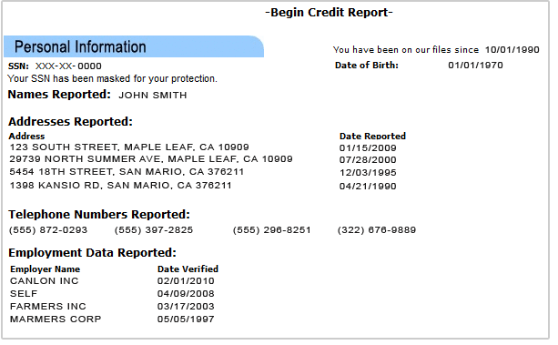
What’s in your credit report?
1) Personal information

Slide 7
2) Public records
Public records
ROCKWELL MUNICIPAL Docket#: 9B004875
5468 MLK AVE., SUITE 300, ROCKWELL, TX 97845 | Type: Civil judgment Court type: Municipal Date paid: 07/2012 Assets: $1,089 | Date filed: 12/2011 Responsibility: Participant on account Plaintiff: BANK OF TEXAS Plaintiff attorney: RICHARD PERRY Amount: $1,089

Slide 8
3) Accounts in good standing
GMAC FINANCING #640006137129
78901 JENKINS CIR FLOOR 15 MIAMI, FL 33025 Phone number not available | Balance: $1,145 Date updated: 08/2017 High balance: $10,000 Collateral: 2009 Dodge Ram Credit limit: $10,000 Past due: $0 Terms: $295 for 36 months | Pay status: Pays as agreed Account type: Installment account Responsibility: Individual account Date opened: 11/2013 Date closed: 11/2016 Date paid: 11/2016
Loan type: Automobile Remarks: Paid by insurance Estimated date that this item will be removed: 12/2023

Slide 9
4) Negative accounts
COLLECTION RECOVERY SVC #321568
123 CHARLES ST. SUITE 202 CORONA, CA 92877-0137 (909) 898-4424 | Balance: $0 Date verified: 06/2011 Original balance: $243 Original creditor: SEARS ROEBUCK Credit limit: $500 Past due: $0 Terms: $72 for 23 months | Pay status: Payment after charge off/collection Account type: Installment account Responsibility: Individual account Date opened: 03/2008 Date closed: 05/2014 Date paid: 05/2014

Slide 10
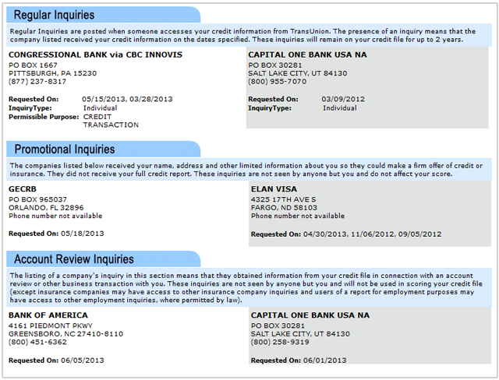
5) Credit inquiries, hard and soft

Slide 11
How long can items stay on a report?
Unpaid debts may be reported for 7 years
  Add 180 days for items in collection.
  Sale of debt to another party does not change the time period.
Tax liens may be reported for 7 years after payment, or 7 years after the lien becomes ineffective.
Judgments may be reported for 7 years from the date of entry, or until the limitations period on enforcement of the judgment has passed, whichever is longer.
Bankruptcies may be reported for 10 years from filing.
Criminal convictions may be reported indefinitely.

Slide 12
Obtaining your credit report
Get and fix reports from 3 main agencies – Equifax, Experian, Trans Union.
Right to free report from each agency 1 time per year.
Can get all 3 at once, or space out obtaining reports during the year.
Also: Right to a free report if credit denied or rate raised due to information on that agency’s report.
Also: Right to a free report if reason to believe that you are victim of credit fraud or identity theft. Request triggers a fraud alert in credit file.

Slide 13
Working with Legal Services Plan to obtain your report
The website to use: www.annualcreditreport.com
Other websites or services will try to sell you report or services.
For Plan help, open a Plan file (1-800-482-7700).
You will work with a Plan attorney and a Plan paralegal specialist.
Plan specialist will use 3-way telephone call with you and the automated annualcreditreport,com service to order your credit report. Reports can also be obtained directly on the website or by mail.

Slide 14
Correcting reports – What you CAN’Tdo
You can’t get rid of accurate and timely items on your report. Beware people who promise they can!
You can’t “create a new identity” to wipe your credit history clean.
You can’t fix credit problems by leaving information out of an application.
Don’t trust “credit repair” companies that make these promises. You don’t need to pay for help – your legal services plan can help you use your legal rights.

Slide 15
Correcting reports – What you CAN do
You can dispute any item or piece of information on your report with the credit reporting agency, which has to reinvestigate without charge.
You should dispute
  Any item you know is wrong
  Any item you believe is wrong, or amount you believe is incorrect
  Any item, debt or account you do not recognize as yours

Slide 16
Reviewing report – What to look for
Accounts or debts you do not recognize
Accounts or debts listed with inaccurate outstanding amounts, or listed multiple times
Public records that do not appear to be yours
Accounts or debts paid off or discharged in bankruptcy that do not include this information
A debt too old for listing. Watch debts sold to debt buyers for “re-aging”
“Hard” inquiries for applications for credit you never made
Payments missing from payment histories

Slide 17
Getting the re-investigation
Your Plan paralegal specialist will review the report with you to identify possible errors
You will need to collect and supply documents, if any, that support a dispute about any item
The specialist will draft a dispute letter, and then provide all information, the dispute draft and documentation to your Plan attorney
The Plan attorney will review, consult with you, and submit the dispute to the reporting agency and to each creditor involved

Slide 18
The re-investigation
Agency has to acknowledge error report within 5 days, inform creditor
The creditor has to conduct a reasonable investigation, report back to agency
Agency must do its own investigation and report to you
At end of 45 day period, agency must either
  Verify disputed information or
  Correct error in disputed information or
  Delete the disputed item or information

Slide 19
After the re-investigation
The agency must notify you of the results of its investigation
If changes are made, the agency must provide a revised report
If an item is not changed, you have a right to submit a statement of dispute for inclusion in future reports
  Your Plan attorney will help you submit a statement for your report
Reports don’t have to be perfect, but the investigation must be reasonable

Slide 20
Other actions to improve credit reports
If you are behind on an account, work to get current
  Payment history is the top factor in credit scores
  Payment history going forward will become more important than past payment problems
Pay down high credit balances, and try to keep them low
  Amount owed is the important factor for credit scores
  Don’t run up card amounts close to credit limits
  Don’t pay on very old debt – will go off report and could revive suit on debt
Limit the number of new credit cards and other credit

Slide 21
Protections against identity theft
Identity thieves often take out loans or new credit cards in victim’s name, using victim’s credit record
Security freeze stops report from use until freeze lifted by consumer – most effective
  Charges differ state-to-state, free from Equifax until June 30, will be free from all starting later this year
  Consumer has to act to lift to obtain credit, then re-impose
Fraud alert notifies creditors of possible problem
  Consumer can request if believes has been victim of fraud or ID theft
  Free, lasts 90 days but can be renewed

Slide 22


Challenging billing errors on credit card statements
Gasoline . . $20
Dating service ...

Slide 23
“Billing Errors” that you can challenge on a credit card statement
You didn’t order the item or service at all, or for that amount
Someone else ordered, without any authority from you
You didn’t receive the item or service as ordered
  Incorrect item or service was rejected by you
  Can’t use billing error challenge for quality issues alone
You didn’t get credit on the statement for a payment or return

Slide 24
How to give notice of a billing error
Notice must go to the credit card company
  Good idea to write the seller as well
Notice needs to be in writing (and keep a copy)
  Credit card company may accept oral information, but you need to confirm in writing to protect your rights
Notice must be received by the credit card company within 60 days after the first statement with the charge on it was sent to you

Slide 25
Content of your letter giving notice of an error
Identify the disputed item
  Can attach copy of statement with item circled, and refer to in accompanying letter
Explain what the issue with that item is
  Include detail if item incorrect, sent back, etc
Enclose copies of documents if there are any
  Copy of receipt for return shipment for instance

Slide 26
Credit card company’s duties after notice
Credit card company can’t act to collect on item, or charge interest for it, until investigation is complete
You can withhold payment of item (not other charges) until completion, or pay it without losing your right to contest
Credit card company must make reasonable investigation
Investigation must be completed within next two billing cycles after receipt of customer’s error notice
No adverse credit report

Slide 27
Your legal services plan can help
Legal Services Plan provides office work by attorneys and paralegals for consumer contract issues, with sellers and credit card companies
Call Plan early in process, to make sure you are protected. 1-800-482-7700.
Even if the 60-day period for notice of errors has passed, you may have other rights you can assert

Slide 28

It’s Your Plan
Call to open a case: 800-482-7700
© 2018 UAW-FCA-Ford-General Motors Legal Services Plan

