Slide 1
Traffic Ticket Tips
How your Legal Services benefit can help
UAW FCA-Ford-General Motors Legal Services Plan

Slide 2
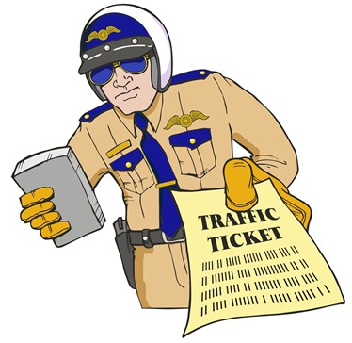
Benefit Coverage
Office Work benefit for traffic tickets, moving violations
Legal advice about your options
Coaching for court appearance if attorney not needed
Low-cost referral if you need an attorney or charge was for
DWI, possession of controlled substance, auto license revocation,
misdemeanor or felony
.

Slide 3
Call your Plan attorney first
Paying the ticket = guilty plea
Points
Higher insurance premiums

Slide 4
Your Plan attorney will ask you:
What was the violation?
When was the ticket issued?
Have you missed your court date?
Where was the ticket issued? Jurisdiction makes a difference.
What is your driving record?
Past tickets and points can stay on your record for as little as 2 years to as much as 3-5 years depending on violation, sentence, state.
Older violations may not count toward increased penalties.
Getting several tickets in a short time can make it harder to get agreement for lower charge.

Slide 5
More questions
Did you argue with the officer?
This can impact reaching a deal
Be respectful
Was there an injury or property damage?
Raises the issue of liability for damages
May need to submit insurance claim
Possible civil lawsuits should be discussed with your attorney

Slide 6
Strategizing with your attorney
Do you want to contest the ticket?
Evaluate whether the ticket was valid
May be hard to win against officer’s testimony
Do you want to avoid the insurance increase?
Could try to reach deal that does not result in points
Are you comfortable representing yourself in court after getting advice and guidance?
May be the most cost effective and advisable option

Slide 7
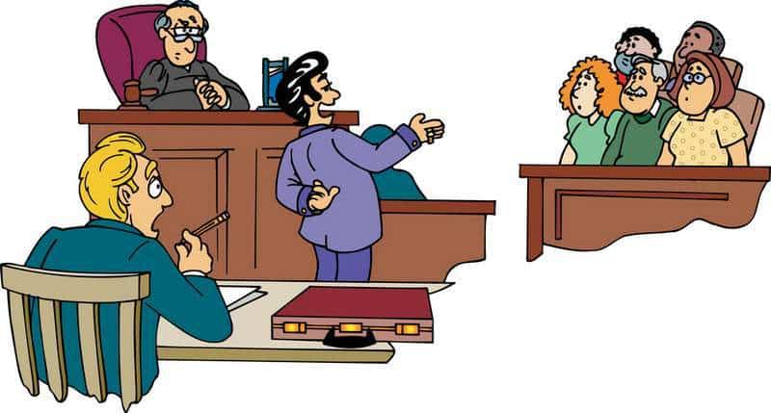
Representing yourself (Pro Se)
Your Plan attorney may advise you to ask for an informal hearing (if that is an option in your jurisdiction).
At the hearing (usually a low-key proceeding):
A judge or magistrate
Prosecutor or attorney representing the jurisdiction
Officer who issued the ticket (sometimes they don’t attend)
Your Plan attorney will advise you:
About local court procedure
Whether you should represent yourself in that locality
Hearing place, date, time
Who to check in with (usually the city attorney)

Slide 8
Tips when representing yourself
What to request of the city attorney:
If you have a good driving record, “impeding traffic” or other charge that does not come with points
Plea under advisement – pay fine but no points if no other infractions within certain period of time
If a formal hearing, ask prosecutor to reduce charge if advisable
Never speak poorly of the police officer.
If the officer does not attend, you may ask for ticket dismissal. Discuss with your Plan attorney beforehand.
If you want to contest the charge:
Understand the risks – If you are found guilty, you will likely have to pay the ticket and get points which could increase your insurance premiums for years.
Consider bringing witnesses who can testify on your behalf – For example, someone who could say the light was not red when you drove through the light.
REMEMBER: BE CALM, POLITE, AND RESPECTFUL TO EVERYONE

Slide 9
When to get a low-cost referral
If your license could be suspended or terminated because of points
If the charge involves:
driving under the influence,
possession of a controlled substance,
driving with an expired license,
or any other misdemeanor or felony
If the ticket arose out of personal injury accident.
If you don’t think you can handle the hearing on your own.

Slide 10
The court ruled against me. Now what?
YOU MAY HAVE ANOTHER OPTION: DRIVER IMPROVEMENT CLASSES
With successful completion:
You may be able to reduce how long points stay on your record in some states.
In other states, you may be protected from having the ticket and points reported to your insurance company
ASK YOUR ATTORNEY IF THIS CLASS IS AN OPTION IN YOUR STATE

Slide 11
Points to remember
Paying the fine = a guilty plea = points + increased insurance premiums
If you don’t show up for your court date and pay the fine, the court may issue a bench warrant and your license may be suspended.
If you plead guilty or are found guilty:
You’ll be fined and points will be added to your driving record.
Points will stay on your record for years (varies from state to state).
Your license may be suspended if you have enough points.
Points increase insurance premiums.
ALWAYS CONSULT YOUR PLAN ATTORNEY

